Slide 1
COTS Software Selection
Lecturer: Ngo Huy Bien
Software Engineering Department
Faculty of Information Technology
VNUHCM - University of Science
Ho Chi Minh City, Vietnam
nhbien@fit.hcmus.edu.vn

Slide 2

Objectives
To evaluate and select COTS software

Slide 3

Contents
COTS Products
COTS Evaluation Methods
Multi Criteria Decision Making

Slide 4

References
Alejandra Cechich et al. (Eds.) (2003). Component-Based Software Quality - Methods and Techniques. Springer.

Slide 5

Building or Buying?

Slide 6


Building
Complete control
Tailored to unique business needs
Ownership of the software code
Knowledge and expertise
Thousands of hours of research and development

Slide 7

COTS Products [2]
Commercial Off-The-Shelf (COTS) products
Component-Based software development (CBSD):
assembling previously existing components (COTS or other non-developmental items) into larger software systems, and
migrating existing applications towards component-based systems.

Slide 8

COTS Issues
Using in different contexts (customization, vendors’ help).
The absence of source code (pay more for it).
Lack of access to the software engineering artifacts originally used in the design of the components (pay more for it).
Trust: no embedded malicious behavior.

Slide 9

So, Building or Buying?
Re-inventing the wheel?
Learning from others and implementing what has been shown to work.

Slide 10

A Way To Guarantee The Failure
Buy a commercial off-the-shelf package and customize it a lot.

Slide 11

Another Way To Guarantee The Failure

Slide 12


Slide 13

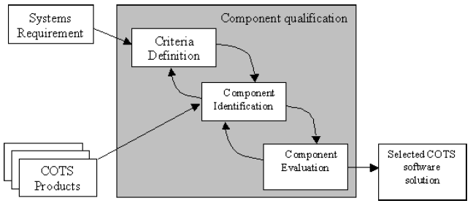
COTS Software Selection
COTS software selection is a process of determining “fitness for use” of previously-developed components that are being applied in a new system context.

Slide 14


COTS Evaluation Methods (I)
Paper evaluation: sales brochure, technical documents, telephone conversations, web site information.
Market survey: questionnaires and interviews with vendors, trade shows, user community.
Vendor analysis: installation assistance, training services and warranty, vendor reputation and vendor stability.

Slide 15
COTS Evaluation Methods (II)
Experimentation:
acquisition and installation of the product,
design of the appropriate prototype and test plan,
evaluation of product and generation of report.
Pilot study: an extended version of experimentation in which “real” data from the organization is used in the evaluation.

Slide 16
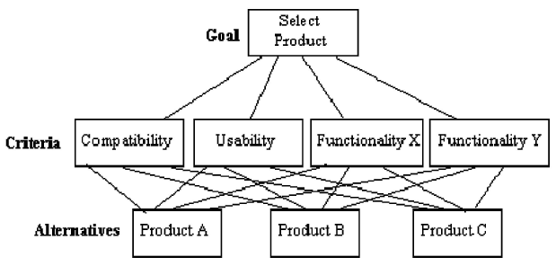

Multi Criteria Decision Making
The basic concepts of Multi Criteria Decision Making approaches are establishing a set of criteria that products should meet, assigning scores to each criterion based on its relative importance in the decision and then ranking products based on their total scores.
Weighted Scoring Method

Slide 17
Mobile Development Tools Evaluation
App and tool features/Tool | Xcode & Android Studio | Xamarin | React Native | Cordova
Register, login, logout
Create, update, delete a ticket
Performance
Integrated simulator
UI builder

Slide 18
Analytical Hierarchy Process (AHP)
Thomas L. Saaty (1990). How to make a decision - The Analytic Hierarchy Process.
Thomas L. Saaty. (2008). Decision Making With The Analytic Hierarchy Process.
Thomas L. Saaty. (2013). The Analytic Network Process.

Slide 19
Outranking Methods
M. Morisio And A. Tsoukias (1997). IusWare: A Methodology For The Evaluation And Selection Of Software Products.

Slide 20

Thank You & See You Again

